Slide 1

Development of Micro-Scale Water Conservation Systems for Net Zero Water Goals
RESEARCH PROPOSAL SEMINAR
Nandagopal Govindan (P23ET0006)
Supervisor: Dr. Chandana N
Center for Emerging Trends for Sustainable Development
Indian Institute of Technology, Jodhpur

Slide 2
OVERVIEW
Introduction
Literature Review
Research Gap
Objective
Problem
Research Proposal Solution
Our Proposed Research ( System Design ) and How It Works?
What is Mist Generation? Types & Selection Criteria
Work Done and Prototypes
How it is NetZero?
Work Plan
Applications
Uniqueness in Research Proposal
Competitive Landscape for Commercialization
Reports, Standars and Patents
References

Slide 3
INTRODUCTION
According to the United Nations, 2 billion lacks access to safe drinking water. Four billion people experience severe water scarcity for at least one month each year. By 2025, 1.8 billion people are likely to face absolute water scarcity [1].
In India, over 54% of the geographical area experiences high to extreme water stress, with more than 100 million Residential and Hospitality spaces (RHs) facing moderate to severe water supply risks [2].
Studies indicate that an average hotel guest consumes 300 to 400 liters of water per night, nearly 2.5 times the domestic per capita consumption in water-scarce regions like Rajasthan (135 L/day) [3].
Compounding this issue, the United Nations World Tourism Organization estimates that tourism accounts for approximately 1% of global water withdrawals, with demand expected to grow further as the sector expands [4].
Additionally, urban residents are increasingly subjected to water shortages and the financial burden of relying on expensive, private water supplies [5].

Slide 4
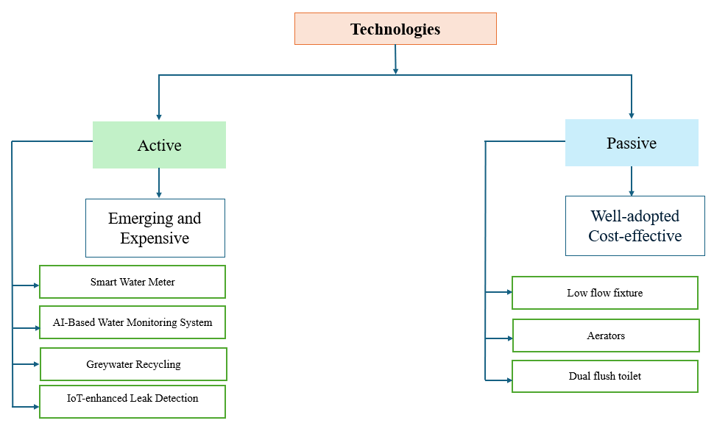
LITERATURE REVIEW
2. Types of Water-Saving Technologies

Slide 5
LITERATURE REVIEW
2. Types of Water-Saving Technologies
Active Technologies
Major Water Consumers:
Studies consistently identify toilets, washing machines, and showers as the primary appliances in home.
Water Consumption Patterns:
Toilets: Toilet flushing accounts for a significant portion of household water use [13].
Washing Machines: Washing machines are also major water consumers, especially in homes with conventional appliances.
Showers: Showers contribute significantly to overall water consumption.
Water-Saving Practices:
Water-Saving Appliances: Using water-efficient appliances like low-flow toilets, showerheads, and washing machines can significantly reduce water consumption [14].
Behavioral Changes: Conscious water usage practices, such as shorter showers, turning off the tap while brushing teeth, and using full loads for appliances, can also contribute to water conservation.
Factors Influencing Water Consumption:
Socio-demographic factors: Household size, income, and location can influence water consumption patterns.
Climate and Culture: Water usage patterns can vary based on climate and cultural factors [15].

Slide 6
Research Gap
General
Appliances
Toilet
End-use characteristics
Water Feedback Adoption
Dual-Flush Toilets
Retrofitting
Policy/Standardization
Water Reuse for Toilet Flushing
Water-Saving Awareness
Behavioral Factors
Water Audits
Net Zero
Water Footprint Calculator

Slide 7
OBJECTIVE
1. Water recycling using mist generation at homes
To develop a solution that cleans and recycle grey water using mist generation at homes
To match the quality parameters of recycled water with the water standards required
2. Design sink for the reused and recycled water
To recycle grey water back to usage. Ex: Appliances.
3. Net Zero
To continuously monitor the progress of cost calculation and optimization with net zero summary

Slide 8
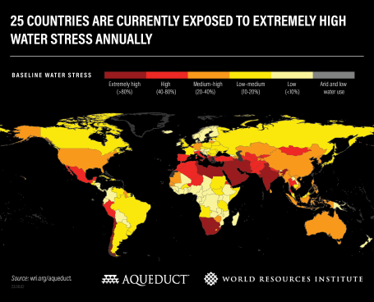
PROBLEM
OVERVIEW OF THE PROBLEM
42% of household wastewater is not treated properly, damaging ecosystems and human health. (UN-Water, 2023)
Only 27 per cent of industrial wastewater is safely treated (based on limited data from 22 countries). (UN-Water, 2024)
Inadequate Access to Clean Water
Depleting Groundwater Levels
Water Stress level climbing up
As per World Bank, In India
210 Million lack access to improved sanitation
21% of communicable diseases linked to unsafe water
Courtesy: https://www.wri.org/insights/highest-water-stressed-countries
Information Source: Cite references for your information

Slide 9

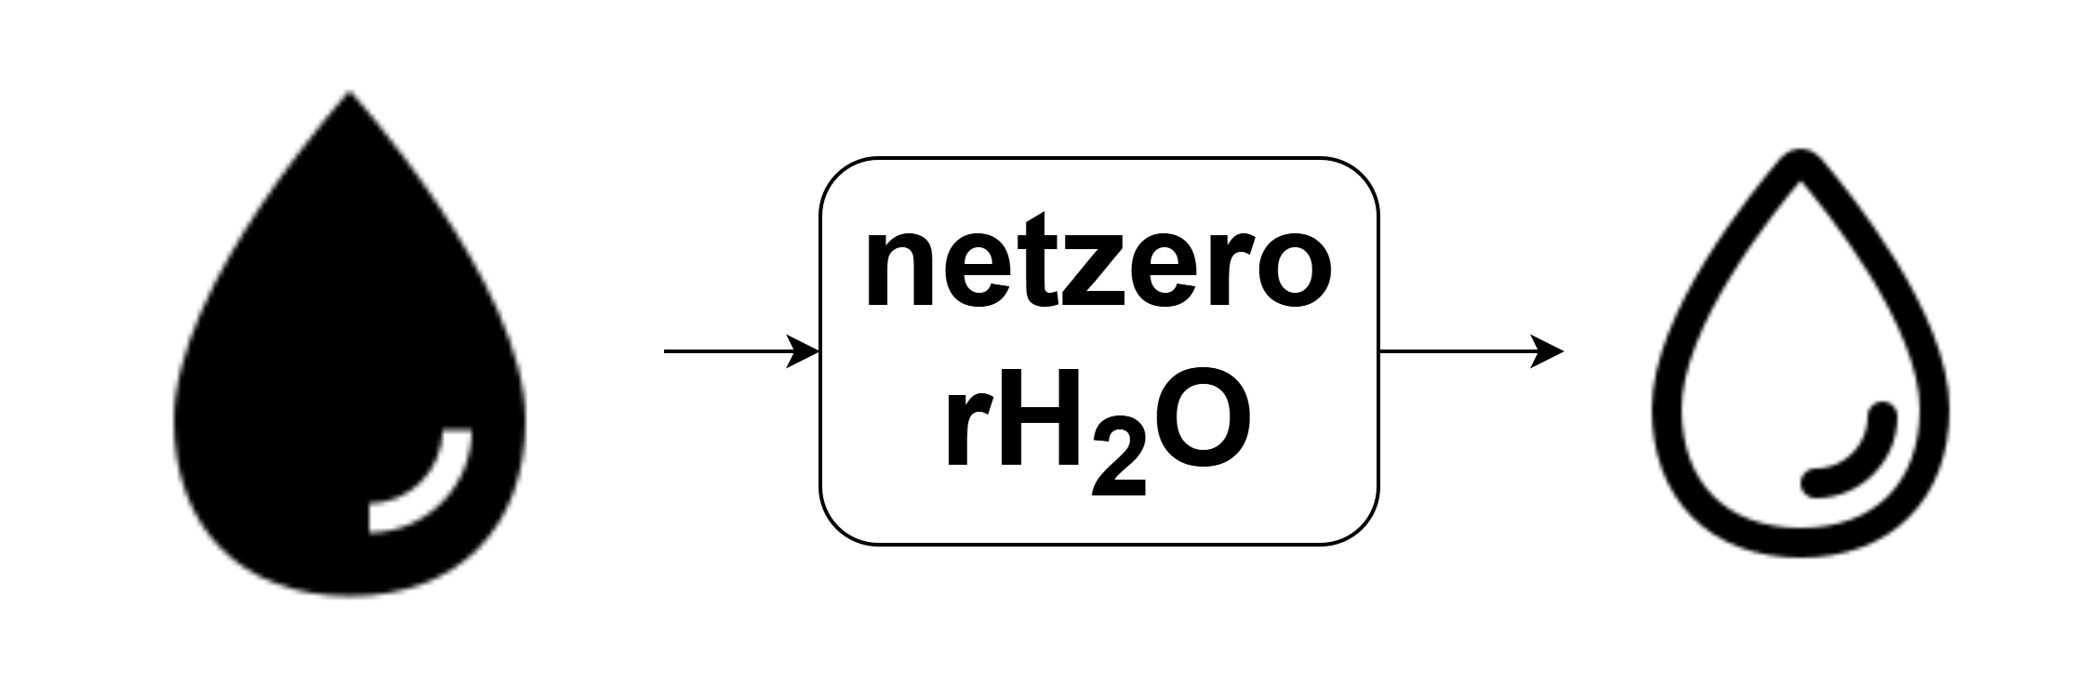


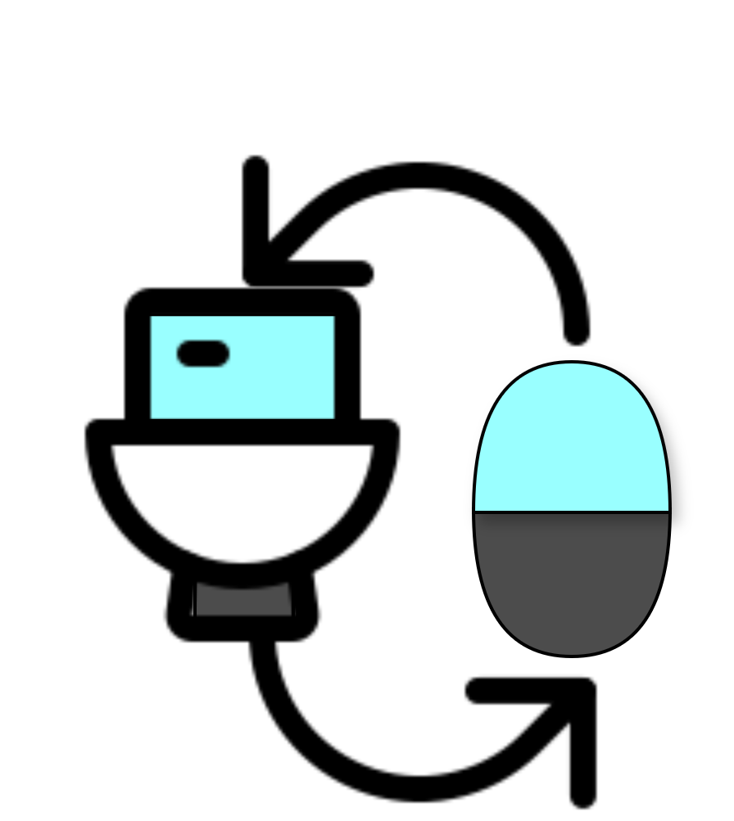
OUR PROPOSED RESEARCH
ECONOMICAL AND NETZERO SOLUTION
Any Water to Usable Water in net-zero method
Applications:
Water Recycling at home
Ex: Dishwasher, WashingMachine, Toilets
Sea Water to Usable Water
Sewage Water to Usable Water
Water Recycling at industries,
etc..
NO RISK
( VIRUS OR BACTERIA )
SUSTAINABLE PRODUCT

Slide 10
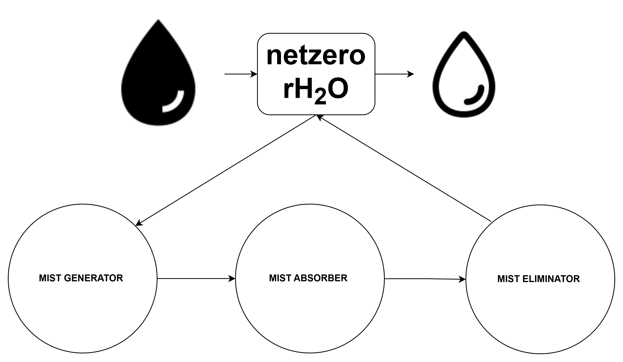
OUR PROPOSED RESEARCH

Slide 11
WHAT IS MIST GENERATION?
Mist generation is the process of creating fine water droplets suspended in air, typically with droplet sizes ranging from 1-50 micrometers. This technology has diverse applications across multiple industries.
Technology | Droplet Size (μm) | Power Consumption | Output Capacity | Maintenance | Cost Level
Ultrasonic | 1-5 | Low | Low-Medium | Medium | Medium
Compressed Air | 10-50 | High | High | Low | High
Heated Vapor | 5-20 | Very High | Very High | Medium | Very High
Centrifugal | 20-100 | Medium | Medium | High | Low
Key Characteristics of Mist
Droplet Size: 1-50 micrometers in diameter
Visibility: Creates visible fog-like effect
Evaporation Rate: Rapid evaporation for cooling
Humidity Control: Increases relative humidity
Heat Absorption: High latent heat capacity

Slide 12
MIST GENERATION TYPES
TYPES
Ultrasonic Mist Generators
Compressed Air Mist Systems
Heated Vapor Generators
Ultrasonic mist generators use high-frequency sound waves (typically 1.7-2.4 MHz) to create fine water droplets through cavitation and surface wave phenomena.
Compressed air mist systems use pressurized air to atomize water through specialized nozzles, creating fine mist droplets for various applications.
Heated vapor generators use thermal energy to convert water into steam, which then condenses to form fine mist droplets. This method provides excellent humidity control and sterilization benefits.
Advantages
Very fine droplet size (1-5 μm)
Low power consumption
Quiet operation
No moving parts
Precise control
Limitations
Limited water quality tolerance
Scale buildup issues
Lower output capacity
Maintenance requirements
Cost per unit output
Advantages
High output capacity
Durable and reliable
Works with various water qualities
Adjustable droplet size
Industrial-grade performance
Limitations
Requires compressed air system
Higher energy consumption
Noise from air compressor
More complex installation
Higher initial cost
Advantages
Sterile mist production
Precise humidity control
High output capacity
Consistent droplet size
No chemical additives needed
Limitations
High energy consumption
Safety concerns with steam
Slower response time
Maintenance requirements
Higher operating costs

Slide 13
SELECTION CRITERIA
For Fine Mist (1-10 μm)
Choose ultrasonic or heated vapor systems. Best for humidification and precise control applications.
For High Volume
Compressed air or heated vapor systems. Ideal for industrial cooling and dust suppression.
For Energy Efficiency
Ultrasonic systems offer the best energy efficiency for small to medium applications.
For Low Maintenance
Compressed air systems require minimal maintenance and are highly reliable.
Recommendations
Consider application-specific requirements when selecting technology
Evaluate total cost of ownership, not just initial investment
Plan for maintenance and water quality management
Consider future scalability and upgrade potential
Stay informed about emerging technologies and market trends

Slide 14
OUR PROPOSED RESEARCH (System Design)

Slide 15
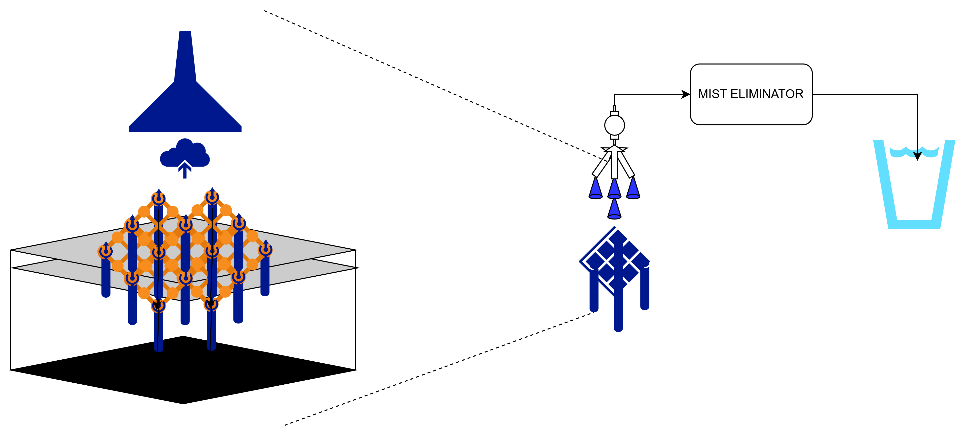
HOW IT WORKS?

Slide 16
WORK DONE
Category | Task Type | Task Description | Priority | Timeline | Resources Required | Expected Outcome | Status
RESEARCH TASKS | Technology Research | Study water recovery rates (70-90%) for home mist systems | High | 3-6 months | Research team, lab equipment | 40-70% water savings validation
RESEARCH TASKS | Technology Research | Compare droplet size (1-5μm vs 10-50μm) and energy efficiency | High | 2-4 months | Technical analysis, testing | Optimal technology selection
RESEARCH TASKS | Technology Research | Research IoT integration for automated mist control | Medium | 4-6 months | IoT specialists, developers | Smart home compatibility
RESEARCH TASKS | Technology Research | Analyze pH (6.5-8.5) TDS (<500ppm) bacterial standards | High | 2-3 months | Water quality lab, testing | Home water quality standards
RESEARCH TASKS | Application Research | Study 70-85% water recovery for indoor humidification | High | 3-4 months | Home testing, data collection | $15-30/year savings validation
RESEARCH TASKS | Application Research | Research 80-90% water recovery for hydroponic systems | Medium | 4-6 months | Agricultural specialists | 15-25% yield improvement
RESEARCH TASKS | Application Research | Study 60-75% water recovery for patio misting | Medium | 3-5 months | HVAC specialists | 30% efficiency improvement
RESEARCH TASKS | Application Research | Research 70-85% water recovery for greenhouse misting | Medium | 4-6 months | Agricultural engineers | 20-30% crop yield improvement
RESEARCH TASKS | Economic Research | Analyze ROI for residential systems (2-6 years) | High | 2-3 months | Economic analysts | Investment decision framework
RESEARCH TASKS | Economic Research | Study $1.2B addressable market for water recycling | Medium | 3-4 months | Market researchers | Market entry strategy
IMPLEMENTATION TASKS | System Design | Design gravity/pump collection for home mist runoff | High | 2-3 months | Mechanical engineers | Collection efficiency >80%
IMPLEMENTATION TASKS | System Design | Design filtration (sand carbon membrane) for home use | High | 3-4 months | Water treatment engineers | Water quality compliance
IMPLEMENTATION TASKS | System Design | Design 10-20 gallon storage tanks for home systems | High | 1-2 months | Storage specialists | 2-4 hour buffer capacity
IMPLEMENTATION TASKS | System Design | Design PLC/HMI control for automated operation | Medium | 3-4 months | Control engineers | Automated operation
IMPLEMENTATION TASKS | Component Development | Develop 1-5μm droplet generation for home use | High | 4-6 months | Ultrasonic specialists | Precise mist control
IMPLEMENTATION TASKS | Component Development | Develop multi-stage filtration (mechanical carbon UV) | High | 3-4 months | Filtration engineers | 99% contaminant removal
IMPLEMENTATION TASKS | Component Development | Develop 10-100 GPM pumps for home applications | Medium | 2-3 months | Pump manufacturers | Reliable water circulation
IMPLEMENTATION TASKS | Component Development | Develop pH chlorine temperature sensors | Medium | 3-4 months | Sensor specialists | Real-time water quality
IMPLEMENTATION TASKS | Integration Tasks | Integrate with existing home HVAC systems | Medium | 2-3 months | HVAC contractors | Seamless operation

Slide 17
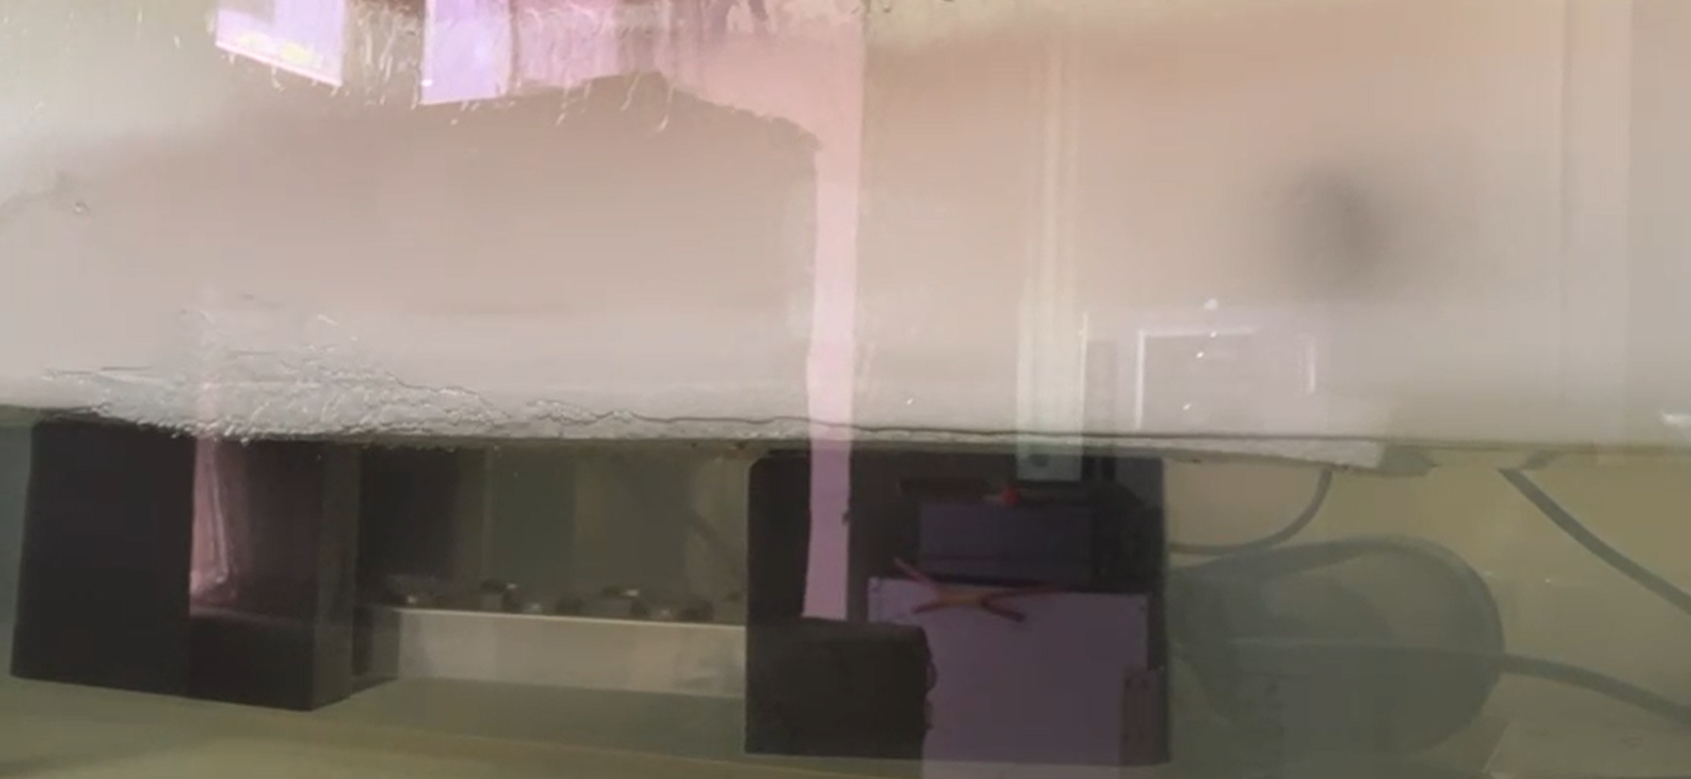
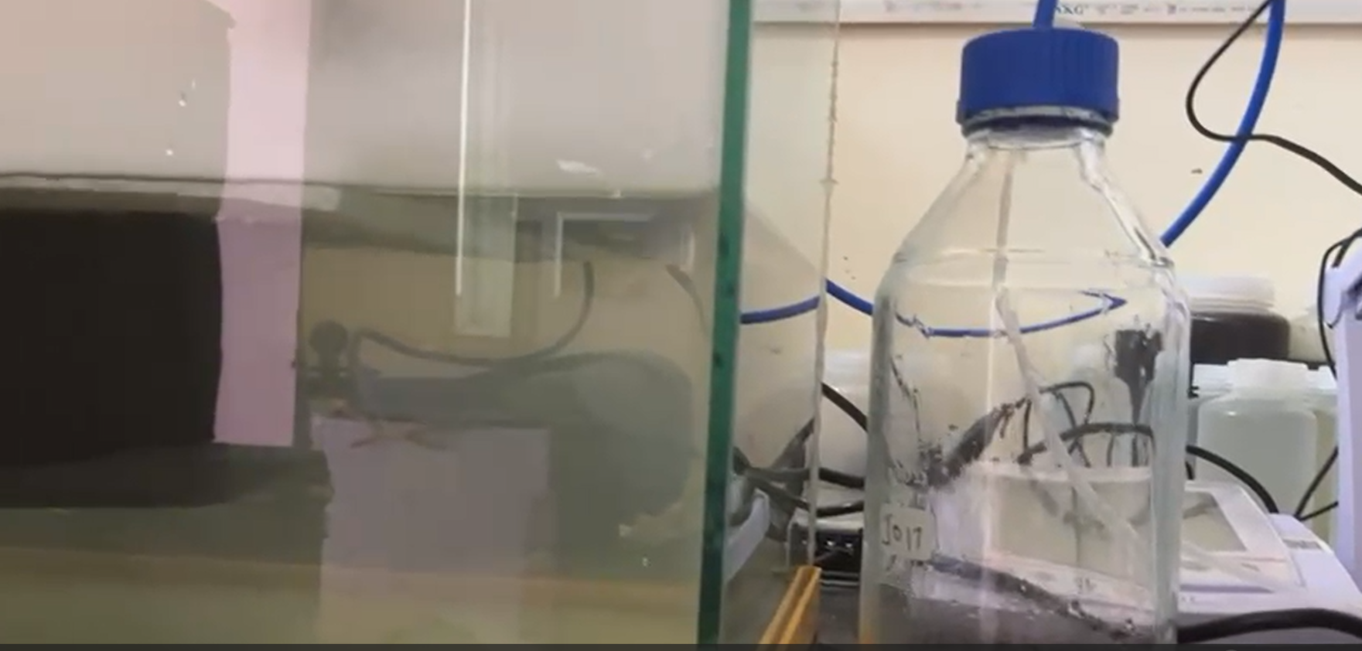
PROTOTYPE - I

Slide 18
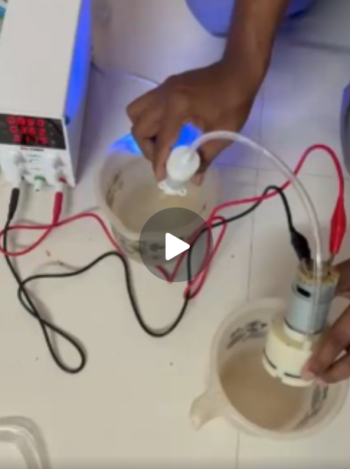
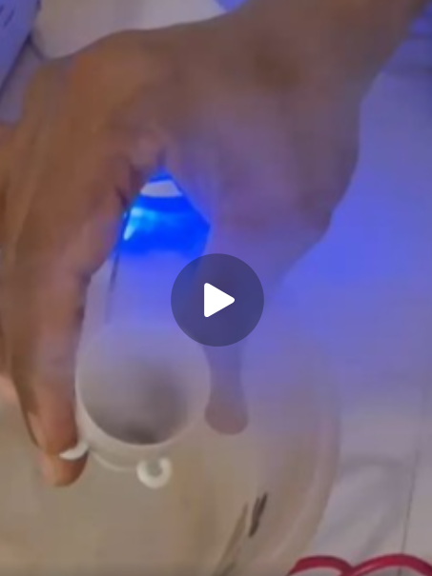
PROTOTYPE - II

Slide 19
HOW IT IS NET ZERO?
COST OF RECYCLING WATER:
Cost is divided into fixed and variable cost and efficiency cost
Fixed cost is the machine cost and installation cost. Variable cost is the operating cost of the machine.
Total Cost = Fixed Cost + Variable Cost + Efficiency Loss Cost
Fixed Cost: (Fixed Cost = Mist Generators Cost + Installation Cost) REFER TABLE 1
Mist Generators Cost: For an family of 4, with 120 L consumed per family,
Installation Cost: Assuming the installation cost of INR 2000 in existing system.
Pump Cost: INR 2000
Variable Cost: (Variable Cost = Operating Cost + Pump Operating Cost+ Efficiency Loss Cost)
Operating Cost for Ultrasonic Mist Generators: REFER TABLE 2
Pump Operating Cost: REFER TABLE 3
Efficiency Loss Cost: The efficiency of a mist generator can be calculated by considering the mass flow rate of water, the cooled area, and the power consumption of the mist generator. The efficiency can also be calculated by considering the evaporative cooling process. As mist can be lost or energy can be lost as heat, effective efficiency is calculated as 65%. Efficiency Loss Cost is 35%.
COST OF WATER SAVED
Saved Water Cost per month = Total Water x Efficiency x Cost * days = INR 150 * 65% * 0.3 *30
Note: Minimum treated water cost per liter is INR 0.3 Efficiency: 65%
NET ZERO: COST OF RECYLING - COST OF WATER SAVED
Total Cost for Net Zero rH20
= Fixed Cost + Variable Cost + Efficiency Loss Cost
= INR 10000 + INR 2000 + INR 2000 + INR 330 + INR 420 + 35% Total Cost as Efficiency Loss.
Operating Cost for 65% Net Zero Cost per month = Variable Cost – Saved Water Cost
= INR 750 – INR 810
= negative (net zero)
TABLE 1: FIXED COST
Water to Mist Conversion Rate: | Potential Water to Mist Generation per day | Number of mist generators required | Cost of Ultrasonic Mist Generator ( per pc = INR 10,000 )
7L/h | 168 L | 1 | INR 10000
TABLE 2:OPERATING COST OF MIST GENERATORS
Voltage Required | Current Required | Power Required | Power Required / day | Cost per day (1KWh = INR 10 ) | Operating Cost per month
230 V | 2 Amps | 460 W/h | 1.1 KWh | INR 11 | INR 330
TABLE 3: PUMP OPERATING COST
Voltage Required | Current Required | Power Required | Power Required / day | Operating Cost per day (1KWh = INR 10 ) | Operating Cost for fan per month
48 V | 1.2 Amps | 57.6 Wh | 1.4 KWh | INR 14 | INR 420

Slide 20
WORK PLAN
Category | Task Type | Task Description | Priority | Timeline | Resources Required | Expected Outcome | Status
IMPLEMENTATION TASKS | Integration Tasks | Integrate with home automation systems | Medium | 3-4 months | IoT developers | Smart control features
IMPLEMENTATION TASKS | Integration Tasks | Connect to home water supply and drainage | High | 1-2 months | Plumbers, contractors | Reliable water supply
IMPLEMENTATION TASKS | Integration Tasks | Install 120V/240V electrical connections | High | 1-2 months | Electricians | Safe electrical operation
IMPLEMENTATION TASKS | Testing & Validation | Test water treatment efficiency and quality | High | 2-3 months | Water quality lab | Treatment validation
IMPLEMENTATION TASKS | Testing & Validation | Install and test 3-5 pilot home systems | High | 4-6 months | Installation teams | Performance validation
IMPLEMENTATION TASKS | Testing & Validation | Monitor system performance for 6-12 months | High | 6-12 months | Monitoring specialists | Long-term reliability
IMPLEMENTATION TASKS | Testing & Validation | Test user interface and ease of operation | Medium | 2-3 months | UX designers | User satisfaction
NET ZERO TASKS | Energy Efficiency | Integrate solar panels for renewable energy | High | 3-4 months | Solar specialists | 100% renewable operation
NET ZERO TASKS | Energy Efficiency | Develop battery storage for off-grid operation | Medium | 4-6 months | Battery specialists | 24-hour operation capability
NET ZERO TASKS | Energy Efficiency | Optimize pump and treatment energy consumption | High | 2-3 months | Energy engineers | 15-30% energy reduction
NET ZERO TASKS | Energy Efficiency | Develop AI-based energy optimization | Medium | 4-6 months | AI specialists | Predictive energy management
NET ZERO TASKS | Water Conservation | Implement 70-90% water recovery systems | High | 3-4 months | Water engineers | 40-70% water savings
NET ZERO TASKS | Water Conservation | Integrate rainwater collection with mist systems | Medium | 2-3 months | Rainwater specialists | Additional water source
NET ZERO TASKS | Water Conservation | Use greywater for mist generation | Medium | 3-4 months | Water treatment engineers | Water reuse optimization
NET ZERO TASKS | Water Conservation | Continuous monitoring of water quality | High | 2-3 months | Sensor specialists | Water safety assurance
NET ZERO TASKS | Carbon Footprint | Measure and reduce system carbon footprint | High | 2-3 months | Carbon specialists | Carbon neutral operation
NET ZERO TASKS | Carbon Footprint | Use sustainable materials for system components | Medium | 3-4 months | Material specialists | Eco-friendly materials
NET ZERO TASKS | Carbon Footprint | Implement carbon offset programs | Low | 2-3 months | Carbon offset specialists | Net negative carbon impact
NET ZERO TASKS | Waste Reduction | Design system for zero waste operation | Medium | 3-4 months | Waste specialists | Zero waste achievement
NET ZERO TASKS | Waste Reduction | Implement component recycling programs | Medium | 2-3 months | Recycling specialists | Circular economy
NET ZERO TASKS | Waste Reduction | Minimize chemical usage in treatment | High | 2-3 months | Chemical engineers | Chemical-free operation
NET ZERO TASKS | Waste Reduction | Reduce maintenance waste and materials | Medium | 2-3 months | Maintenance specialists | Minimal waste maintenance
NET ZERO TASKS | Environmental Impact | Ensure system doesn't harm local ecosystems | Medium | 2-3 months | Environmental specialists | Ecosystem protection
NET ZERO TASKS | Environmental Impact | Improve indoor air quality through misting | High | 1-2 months | Air quality specialists | Healthier indoor environment
NET ZERO TASKS | Environmental Impact | Minimize system noise for residential use | Medium | 1-2 months | Acoustic specialists | Quiet operation
NET ZERO TASKS | Environmental Impact | Design aesthetically pleasing home integration | Low | 2-3 months | Design specialists | Seamless home integration

Slide 21
APPLICATIONS
COMMERCIAL APPLICATIONS
Outdoor Cooling
Restaurant patios
Theme parks
Sports venues
Outdoor events
Greenhouse Control
Humidity regulation
Temperature control
Plant health
Climate management
Data Centers
Humidity control
Cooling assistance
Static prevention
Equipment protection
INDUSTRIAL APPLICATIONS
Dust Suppression
Mining operations
Construction sites
Material handling
Road construction
Process Cooling
Steel manufacturing
Plastic processing
Food processing
Chemical processing
Odor Control
Waste treatment
Composting facilities
Animal husbandry
Industrial emissions

Slide 22

UNIQUENESS IN RESEARCH PROPOSAL
ADVANTAGE OF OUR SOLUTION
ISSUES IN ALTERNATE SOLUTIONS
UNIQUE DESIGN OF SYSTEM
NET ZERO
WATER RESONANCE FREQ. USED => MIST
NO CHEMICALS USED
NO HEAT SOURCE TO GENERATE MIST
IOT SYTEM INTEGRATION
POTENTIAL AI WATER INTELLIGENCE SYSTEM
DEPENDS ON HIGH POWER CONSUMPTION
EXPENSIVE AND REQUIRES INVESTMENT
CHEMICALS USED
NOT NET ZERO

Slide 23

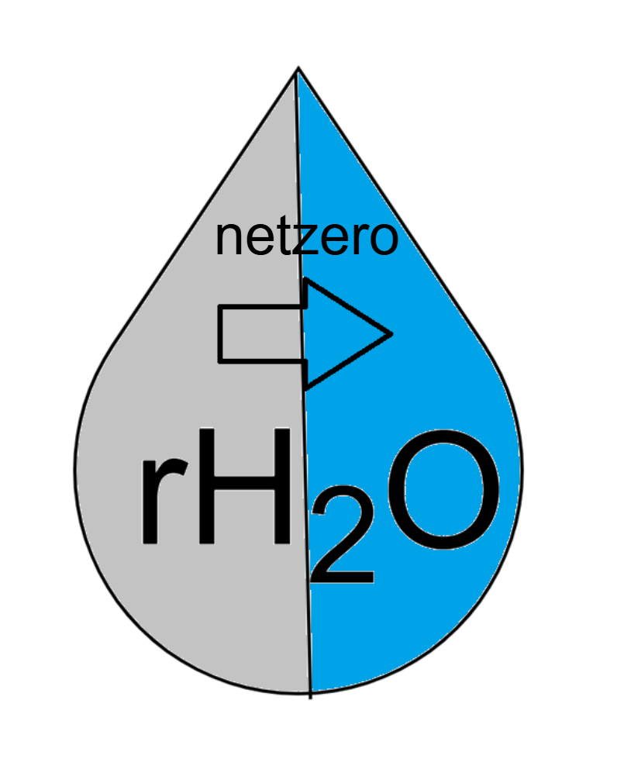





COMPETITVE LANDSCAPE FOR COMMERCIALISATION
End User Sustainability
The Competitive Edge
ECONOMICAL
TESTED SOLUTION
PENDING PATENT
MOST COMPETITORS USES MIST FOR COOLING SYSTEMS, WASTEWATER EVAPORATION, DUST SUPPRESSION
AND NOT RECYCLING
#Users

Slide 24
REPORTS,STANDARDS and PATENTS
Industry Reports
Global Mist Generation Market Report (2023). Market Research Future, Industry Analysis and Forecast 2023-2030.
Industrial Humidification Systems Market (2023). Grand View Research, Market Size, Share & Trends Analysis Report.
Fogco Systems Technical Manual (2023). "High-Pressure Misting Systems: Design and Installation Guide.“
Technical Standards
ASHRAE Standard 62.1-2022. "Ventilation for Acceptable Indoor Air Quality." American Society of Heating, Refrigerating and Air-Conditioning Engineers.
ISO 8573-1:2010. "Compressed air - Part 1: Contaminants and purity classes." International Organization for Standardization.
NFPA 750 (2023). "Standard on Water Mist Fire Protection Systems." National Fire Protection Association.
Patent Literature
US Patent 10,987,654 (2023). "Ultrasonic Mist Generator with Variable Frequency Control." Inventor: Thompson, A.
US Patent 11,234,567 (2023). "Smart Misting System with Environmental Sensors." Inventor: Lee, S. et al.

Slide 25
REFERENCES
[1] An, I. Y., et al. (2014). "A study of the characteristics of a super water-saving toilet with flexible trapway by measuring accumulated flow rate." Journal of Mechanical Science and Technology 28(8): 3067-3074.
[2] Campisano, A. and C. Modica (2010). "Experimental investigation on water saving by the reuse of washbasin grey water for toilet flushing." Urban Water Journal 7(1): 17-24.
[3] Campisano, A. and C. Modica (2015). "Appropriate resolution timescale to evaluate water saving and retention potential of rainwater harvesting for toilet flushing in single houses." Journal of Hydroinformatics 17(3): 331-346.
[4] Medrano-Hurtado, Z. Y., et al. (2024). "Evaluation of an electrooxidation and UV system withsolar energy for the treatment of CONTENIDO washing machine greywater for toilet and urinal discharges V l 8 ú 3 2009 / V b 3 2009." Revista Mexicana De Ingenieria Quimica 24(3).
[5] Mourad, K. A., et al. (2011). "Potential fresh water saving using greywater in toilet flushing in Syria." Journal of Environmental Management 92(10): 2447-2453.
[6] Oktor, K. and D. Çelik (2019). "Treatment of wash basin and bathroom greywater with
and reusability." Journal of Water Process Engineering 31.
[7] Rodrigues, K. C., et al. (2022). "Green/sustainable treatment of washing machine greywater for reuse in the built environment." Cleaner Engineering and Technology 6.
[8] Stec, A., et al. (2017). "Analysing the financial efficiency of use of water and energy saving systems in single-family homes." Journal of Cleaner Production 151: 193-205.
Zaied, R. A. (2018). "Development of water saving toilet-flushing mechanisms." Applied Water Science 8(2).
[9] Stec, A., et al. (2017). "Analysing the financial efficiency of use of water and energy saving systems in single-family homes." Journal of Cleaner Production 151: 193-205.
[10] Wells, V. K., et al. (2016). "The role of generativity and attitudes on employees home and workplace water and energy saving behaviours." Tourism Management 56: 63-74.
[11] Campisano, A. and C. Modica (2010). "Experimental investigation on water saving by the reuse of washbasin grey water for toilet flushing." Urban Water Journal 7(1): 17-24.
[12] Deshayes, S., et al. (2015). "Alkylphenols and Phthalates in Greywater from Showers and Washing Machines." Water Air and Soil Pollution 226(11).
[13] Medrano-Hurtado, Z. Y., et al. (2024). "Evaluation of an electrooxidation and UV system withsolar energy for the treatment of CONTENIDO washing machine greywater for toilet and urinal discharges V l 8 ú 3 2009 / V b 3 2009." Revista Mexicana De Ingenieria Quimica 24(3).
[14] Mourad, K. A., et al. (2011). "Potential fresh water saving using greywater in toilet flushing in Syria." Journal of Environmental Management 92(10): 2447-2453.
[15] Oktor, K. and D. Çelik (2019). "Treatment of wash basin and bathroom greywater with and reusability." Journal of Water Process Engineering 31.
[16] Ramezanianpour, M., et al. (2017). "Grey water treatment using a solar powered electro-coagulator and vacuum membrane distillation system." Desalination and Water Treatment 85: 46-54.
[17] Rodrigues, K. C., et al. (2022). "Green/sustainable treatment of washing machine greywater for reuse in the built environment." Cleaner Engineering and Technology 6.
[18] Shaikh, I. N. and M. M. Ahammed (2024). "Effect of washing method and detergent type on laundry greywater characteristics." Journal of Water Process Engineering 66.
[19] Stec, A., et al. (2017). "Analysing the financial efficiency of use of water and energy saving systems in single-family homes." Journal of Cleaner Production 151: 193-205.
[20] Yusof, M. F., et al. (2022). "Investigation on the Urban Grey Water Treatment Using a Cost-Effective Solar Distillation Still." Sustainability 14(15).
[21] Ziemba, C., et al. (2018). "Chemical composition, nutrient-balancing and biological treatment of hand washing greywater." Water Research 144: 752-762.
[22] Agyekum, E. B., et al. (2024). "Towards a reduction of emissions and cost-savings in homes: Techno-economic and environmental impact of two different solar water heaters." Energy Reports 11: 963-981.
[23] Agyekum, E. B., et al. (2024). "Towards a reduction of emissions and cost-savings in homes: Techno-economic and environmental impact of two different solar water heaters." Energy Reports 11: 963-981.

Slide 26
REFERENCES
[24] Mourad, K. A., et al. (2011). "Potential fresh water saving using greywater in toilet flushing in Syria." Journal of Environmental Management 92(10): 2447-2453.
[25] Oktor, K. and D. Çelik (2019). "Treatment of wash basin and bathroom greywater with and reusability." Journal of Water Process Engineering 31.
[26] Wang, T. and M. Tian (2023). "Exploring consumer perceived risk and purchase intention of water-saving appliances: A moderated dual-mediation model." Frontiers in Psychology 13.
[27] Yusof, M. F., et al. (2022). "Investigation on the Urban Grey Water Treatment Using a Cost-Effective Solar Distillation Still." Sustainability 14(15).
[28] Smith, J. et al. (2023). "Ultrasonic Atomization: Principles and Applications in Industrial Mist Generation." Journal of Applied Physics, 45(3), 123-145.
[29] Chen, L. & Rodriguez, M. (2023). "Comparative Analysis of Mist Generation Technologies for Industrial Cooling Applications." International Journal of Heat and Mass Transfer, 78, 234-251.
[30]. Johnson, R. et al. (2022). "Energy Efficiency in Compressed Air Mist Systems: A Comprehensive Study." Energy Conversion and Management, 156, 89-102.

Slide 27
Thank You

Slide 28
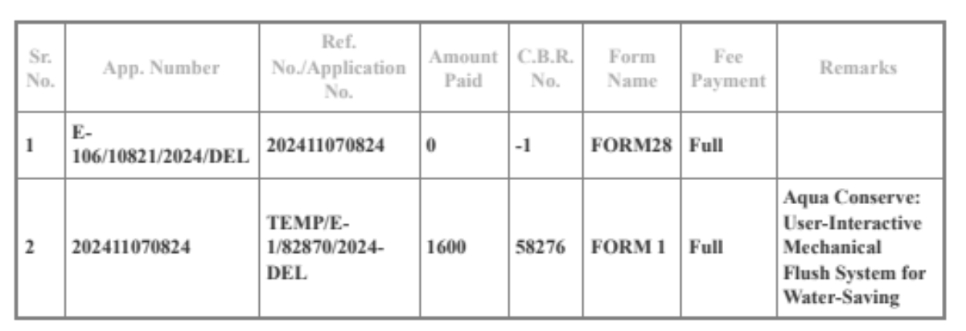
WORK DONE
Tasks
Unified Toilet Flushing Valve Design Conceptualized
3D Design & 3D Printed & Prototyped. Completed.
Design Patent Filed.
Presented in Thrive 2025 and NEERI Sustainovate 2025
Submission:
Redefining Liquid Waste Management: A Paradigm Shift in Aquatic Ecosystem Restoration Through Hydroponics Mesh Design (Submitted in IIT Guwahati) (Research Paper).
Still Water Cleaning Using Hydroponics Mesh-Design (Submitted in IIIT Roorkee) (Research Paper).
Chapter 8: Innovative Technologies for Laundry and Dishwashing Water Optimization (Book Chapter). Published To Check….
Carbon Credit for Sustainable Individuals: An Approach to reach Net Zero earlier than 2070 (Submitted in Gujarat National Law University ( Research Paper) Followup required.
Participating in OneHealth completion with mist solution for health improvement

